Slide 1

Design Review by Team 1
Introduction
Research
Design
Review

Slide 2
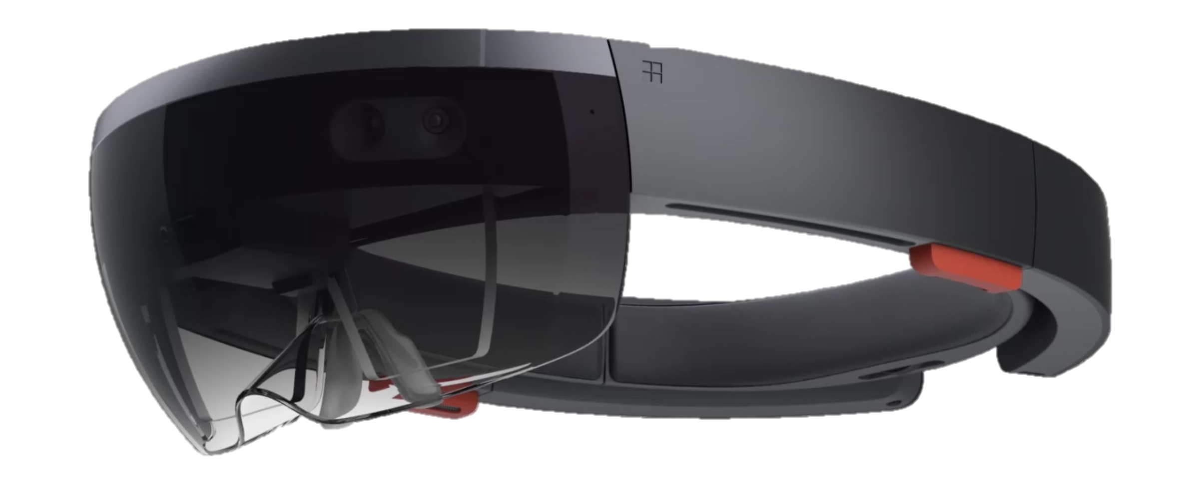

Introduction
Application requirements
An augmented reality play space
Facilitate play for autistic users
Assist with targeted user issues
Target audience
Children aged 8-13
Level 1 & 2 autism spectrum disorder
Trying to play with children with or without autism

Slide 3



Overview
Application core features
Top Trumps style card game
Character models augmented onto cards
Simple and easy to learn rules
Gameplay which encourages interaction
Additional features
Accessibility options
Selection of card themes
Gesture commands
Simplified user interface

Slide 4
Research
User Interface
Use bold and non-abstract icons
Large UI elements
More space between elements
Avoid screen clutter where possible
Interaction
Provide clear visual feedback on every action
Use sound as feedback on actions

Slide 5
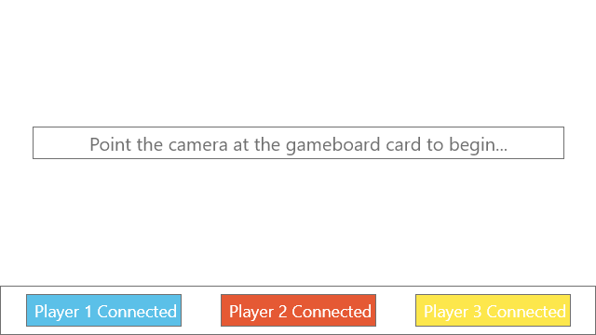
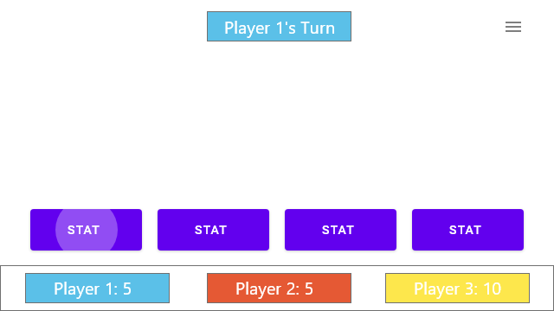
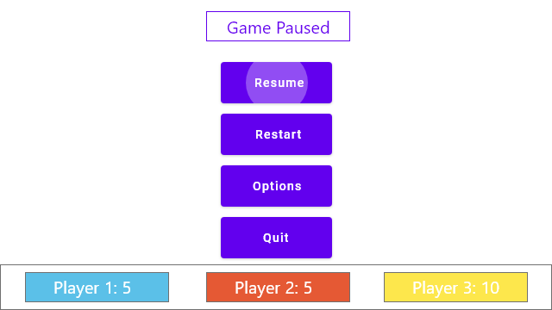
Design
Simple design for ease of use.
Clear & consistent flow through each game-state.
No clutter and maximum transparency in the UI elements to improve visibility of the play-space.

Slide 6

Colour Scheme
Lightly shaded for less eye strain
Distinctly different colours
Consistent throughout application

Slide 7
Review

